Slide 1
Amazon Web Services
Boot Camp - May 2019
Ricardo Peters, AWS TAM
Brian Fanning, AWS TAM

Slide 2
Enterprise Support
Cloud Support Engineers, Solutions Architects, and product teams are available for guidance
TECHNICAL ACCOUNT MANAGER (TAM)
Designated technical point of contact to all necessary AWS expertise
SMEs
SUPPORT CONCIERGE
Dedicated team of enterprise account specialists to help with billing and account subjects
Online resource to help you reduce cost, increase performance, and improve security by optimizing your AWS environment
Assists you when AWS resources are impacted by things such as Spam, Port scanning, Denial of Service attacks (DDoS), or malware
TRUSTED ADVISOR (TA)
PEOPLE
ABUSE
TEAM
EXPERTISE
PERSONAL HEALTH DASHBOARD (PHD)
Delivers alerts and remediation guidance when AWS is experience events that may impact your environment
Focused planning and support business-critical events (e.g. launches or migrations)
INFRASTRUCTURE EVENT MANAGEMENT (IEM)
TOOLS
AUTOMATION
Detailed review of your architecture guidance on how to best design your systems
Programmatic access to AWS Support Center features to create, manage, and close your support cases, and operationally manage your TA check requests and status
STRATEGIC
WELL-ARCHITECTED REVIEW
PROGRAMS
SUPPORT API
Consultative reviews of your application architecture and how to align it with AWS
ARCHITECTURE
SUPPORT
Credits for online self-paced labs provided through an AWS training provider
OPERATIONS
SUPPORT
Consultative reviews of your cloud operations and advice for optimization
TRAINING
Notes:
Born from Earth’s most customer-centric organization, AWS Support is greater than the sum of its parts, combining expert people, tools, and programs to help you succeed with AWS.
The people component of AWS Support provide what many customers tell us is invaluable. TAMs, for example, are so embedded in their customers’ environments that they are often mistaken for internal employees at the customer. The Support Concierge team is specifically trained to help with billing and account questions quickly and with knowledge of the your business and usage of AWS.
AWS Support tools give you the ability to self-service as needed, get proactive alerts, and automate many aspects of your AWS environment so that you can focus on your core business.
Finally, as an ES customer, you can take advantage of strategic planning and guidance, such as regular architecture and operations reviews to ensure compliance with best practices and IEM to make sure that your most critical business events go off without a hitch.

Slide 3


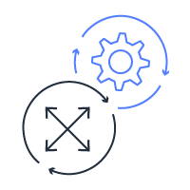

AWS Enterprise Support Benefits
Focus on Your Core Business
Technical Account Manager for proactive coordination
Spend less time on infrastructure, more time innovating
Proactive programs to help accelerate cloud journey
Tools to automate management of AWS environment
Accelerate Innovation
Consultative architecture guidance
Guidance and support for third-party software
Training and knowledge transfer
Coordinated access to AWS subject-matter experts
Reduce Infrastructure Risks
< 15 minute response time for business-critical incidents
Security and fault tolerance recommendations
Well-Architected reviews to increase app reliability
Proactive alerts and remediation guidance from Trusted Advisor
Optimize Your Business
Operations reviews and best practice guidance
Cost & performance optimization recommendations
Proactive planning programs for critical events
Support concierge team to help with billing and account

Slide 4

Technical Account Manager
Reactive Support
Proactive Support
Follow up on running cases
Engage service team
Escalate on you behalf
Answer general guidance questions
Join support calls
Provide RCA when needed
Engage AWS Product team
Access to beta releases
Share AWS services roadmap
Provide Weekly Launch recap
Technology Advocate

Slide 5
Leveraging AWS Support

Slide 6
AWS Support Process
Check the status and personal health dashboards
Public status page confirms AWS is operating normally, personal health dashboard identifies issues that may be impacting your environment
Open a support case with correct severity
Use the phone or chat contact methods for impactful events
TAMs are notified + Reach out directly
Email, phone, chat
Our pagers go off when you open a critical severity case
Notes:
Improve it
EXTEND VALUE
Ask audience who knows the steps.
We will send everyone the official doc with process, contact info, etc.
Main takeaway from this section- always open a support case first
AS soon as possible -- no SLA

Slide 7
AWS Support - Response Times
Severity | First-Response Time | Description / Support Plan
Business-critical system down | 15 min | Your business is at risk. Critical functions of your application are unavailable. (Enterprise support plan)
Production system down | 1 hr | Your business is significantly impacted. Important functions of your application are unavailable. (Business and Enterprise support plans)
Production system impaired | 4 hrs | Important functions of your application are impaired or degraded. (Business and Enterprise support plans)
System impaired | 12 hrs | Non-critical functions of your application are behaving abnormally, or you have a time-sensitive development question. (Developer*, Business, and Enterprise support plans)
General guidance | 24 hrs | You have a general development question, or you want to request a feature. (Developer*, Business, and Enterprise support plans)

Slide 8
AWS Support - Escalations
In situations where an escalation is required, please contact us via the following escalation path:
Submit a support case: (https://aws.amazon.com/support)
Technical Account Managers
Ricardo Peters: ricapete@amazon.com , Cell: +1-705-464-9029
BEST OPTION! Enterprise Team alias: aws-coveo-team@amazon.com
Enterprise Support Manager
Rob Brown: robbrown@amazon.com ,Cell: +1-226-203-3402
Notes:
Submit a support case: This helps us track your request and gives me leverage with service teams down the track
Escalation path: These details will be provided after the meeting.

Slide 9
Introduction to Amazon Cloud & EC2 Overview
Ricardo Peters, ricapete@amazon.com
Brian Fanning, bfannin@amazon.com
May 8th 2019

Slide 10
Agenda
Introduction to AWS Cloud
Global Reach
EC2 Overview
EC2 Details
Notes:
Overview of the day – let customers know what this presentation is about.

Slide 11
What is AWS?
AWS provides a highly reliable, scalable, low-cost infrastructure platform in the cloud that powers millions of businesses in 190 countries around the world.
Benefits
Low Cost
Elasticity & Agility
Open & Flexible
Secure
Global Reach
Notes:
http://aws.amazon.com/what-is-cloud-computing/
http://aws.amazon.com/about-aws/

Slide 12

What sets AWS apart?
Experience
Building and managing cloud since 2006
Service Breadth & Depth
145+ services to support any cloud workload
Pace of Innovation
History of rapid, customer-driven releases
Global Footprint
20 regions, 60 availability zones, 150+ edge locations
Pricing Philosophy
69 proactive price reductions to date
Ecosystem
Thousands of consulting/system integrator & technology partners
Notes:
TALKING POINTS
Customers have selected AWS for eight years because we have proven ourselves committed to customer success.
We believe we stand apart in the market because of six factors: Experience, Service Breadth and Depth, Pace of Innovation, Global Footprint, Pricing Philosophy, and Partner Ecosystem
The AWS Partner Network (APN) includes tens of thousands of consulting/systems integrator and technology/ISV partners, and has grown over 50% over the past 12 months.

Slide 13
Experience with Operational Reliability
Our goal is to make our operational performance indistinguishable from perfect. We are driven to remove any all causes of failure.
We have spent over a decade building the world’s most reliable, secure, scalable, and cost-effective infrastructure.
Service SLAs between 99.9% and 100% availability. Amazon S3 is designed for 99.999999999% durability.
Availability Zones exist on isolated fault lines, flood plains, and electrical grids to substantially reduce the chance of simultaneous failure.
The AWS Service Health Dashboard provides 24/7 visibility in the real-time operational status of all services around the globe.
Notes:
TALKING POINTS
Our eight years in the cloud computing market has provided us with a long runway to hone our experience delivering massive scale infrastructure.
There are two areas where our experience particularly shines through, the first is in operations.
Even before we launched our first service, we were focusing on the architecture and operation of globally distributed data centers.
Our engineers are relentless in their pursuit to eliminate potential causes of failure.
Taking advantage of multiple AZ’s provides exceptional operational stability.
We are committed to 100% transparency for the operational health of the entire global infrastructure.
SLAs
Highest availability SLA is 100% for Route53. EBS is 99.999%.
http://aws.amazon.com/route53/sla/
http://aws.amazon.com/ebs/details/#availabilityanddurability

Slide 14
Pricing Philosophy
High volume / low margin businesses are in our core DNA
Trade CapEX for variable expense
Our economies of scale provide us with lower costs
Pricing model choice to support variable and stable workloads
Save more money as you grow bigger
Pay for what you use
69 price reductions since 2006
On-demand
Reserved Instances
Spot
Tiered pricing
Volume discounts
Custom pricing
Notes:
TALKING POINTS
Cloud computing is inherently a high volume, low margin business. Our company DNA makes us extremely comfortable in such an environment.
Our massive scale provides huge economies of scale, which lowers our costs considerably. We are also committed to increasing utilization and streamlining operations. The combined savings of these factors, allow us to proactively and regularly decrease customer costs.
Multiple pricing models allow you to balance cost and flexibility.
Tiered pricing and volume discounts provide a means for your costs to decrease when your usage increases.
Since its introduction last year, AWS Trusted Advisor has made over 1M recommendations to customers about how they can lower their costs, totaling a combined annual savings of more than $200M.

Slide 15

Customer obsessed
90%
of roadmap originates with customer requests and are designed to meet specific needs
“Performance, reliability, and responsiveness are fundamental to our customer experience, and T3 instances help us to deliver on that customer promise while also controlling our costs.”
—Heroku
Notes:
Our leadership in compute and cloud is grounded in customer obsession. We innovate on behalf of you and your needs. Today, 90% of our product roadmap is based on customer feedback – what you’ve told us that you need. Its our customers which are pushing on the boundaries of what is possible today and driving us to enable new scenarios and capabilities.

Slide 16
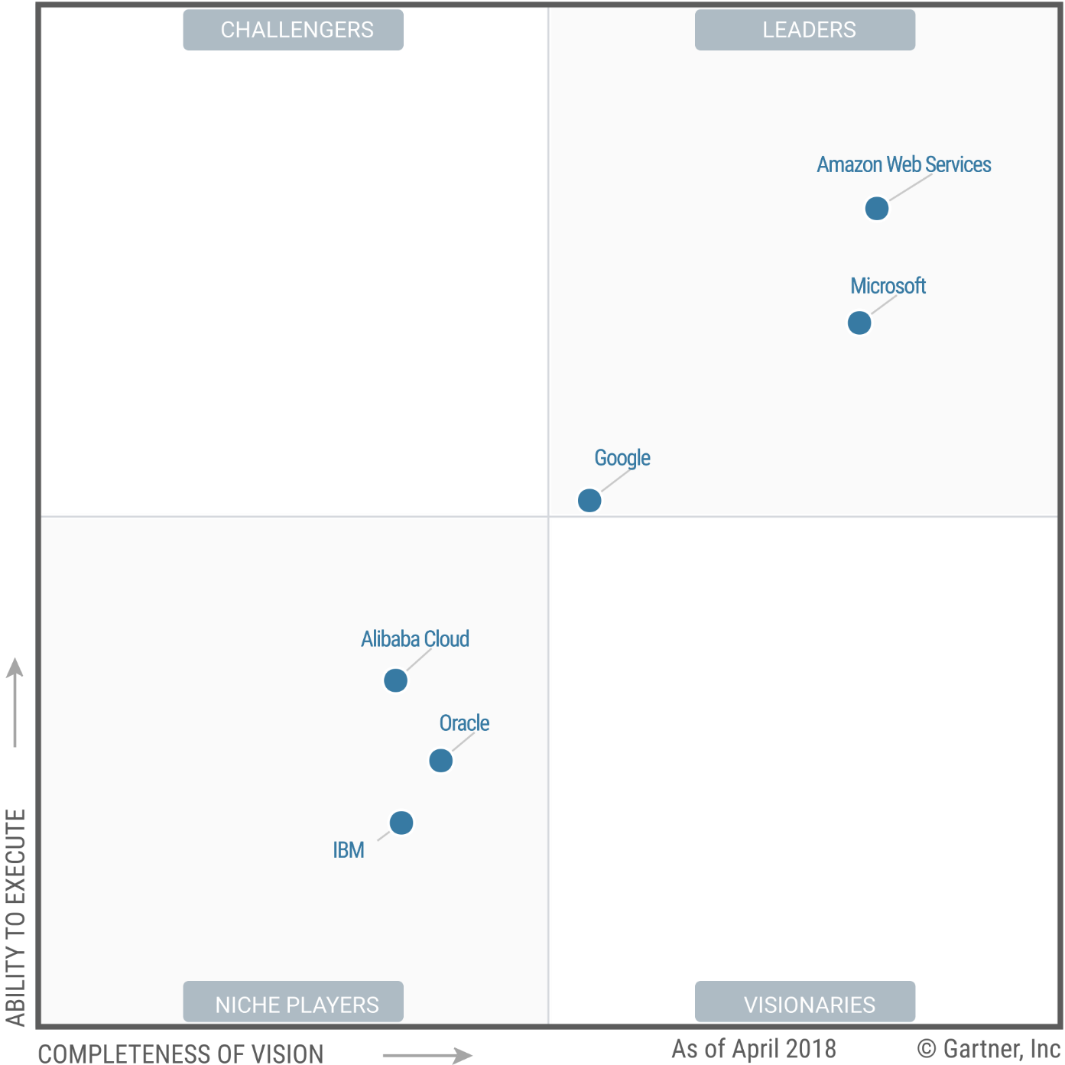
AWS positioned as a leader in the Gartner Magic Quadrant for Cloud Infrastructure as a Service
AWS is positioned highest in execution and furthest in vision within the Leaders Quadrant
*Gartner, Magic Quadrant for Cloud Infrastructure as a Service, Worldwide, Smith, Dennis, Leong, Lydia, Bala, Raj, May 2018 G00336148
This graphic was published by Gartner, Inc. as part of a larger research document and should be evaluated in the context of the entire document. The Gartner document is available upon request from AWS : https://www.gartner.com/doc/reprints?id=1-2G2O5FC&ct=150519&st=sb Gartner does not endorse any vendor, product or service depicted in its research publications, and does not advise technology users to select only those vendors with the highest ratings or other designation. Gartner research publications consist of the opinions of Gartner's research organization and should not be construed as statements of fact. Gartner disclaims all warranties, expressed or implied, with respect to this research, including any warranties of merchantability or fitness for a particular purpose.
Notes:
Here you can see the clear leadership of AWS in the cloud. The Infrastructure as a Service Magic Quadrant is the longest-running cloud magic quadrant and AWS continues to be in the leadership quadrant, with the highest position in execution and furthest in vision top position. Over you look at the Infrastructure as a Service Magic Quadrant over the years, what you see if that there are fewer dots on the graphic. Delivering the cloud at massive scale is hard, the bar for cloud keep raising and fewer vendors over time are able to keeping innovating to provide these capabilities. Proven experience in this space matters and AWS continues to show its leadership.

Slide 17
1
AWS Global Reach

Slide 18


89 AWS Direct Connect locations
20 Regions

Slide 19
150 Amazon CloudFront Points of Presence
19 Regions
89 AWS Direct Connect locations

Slide 20
150 Amazon CloudFront Points of Presence
89 AWS Direct Connect locations

Slide 21
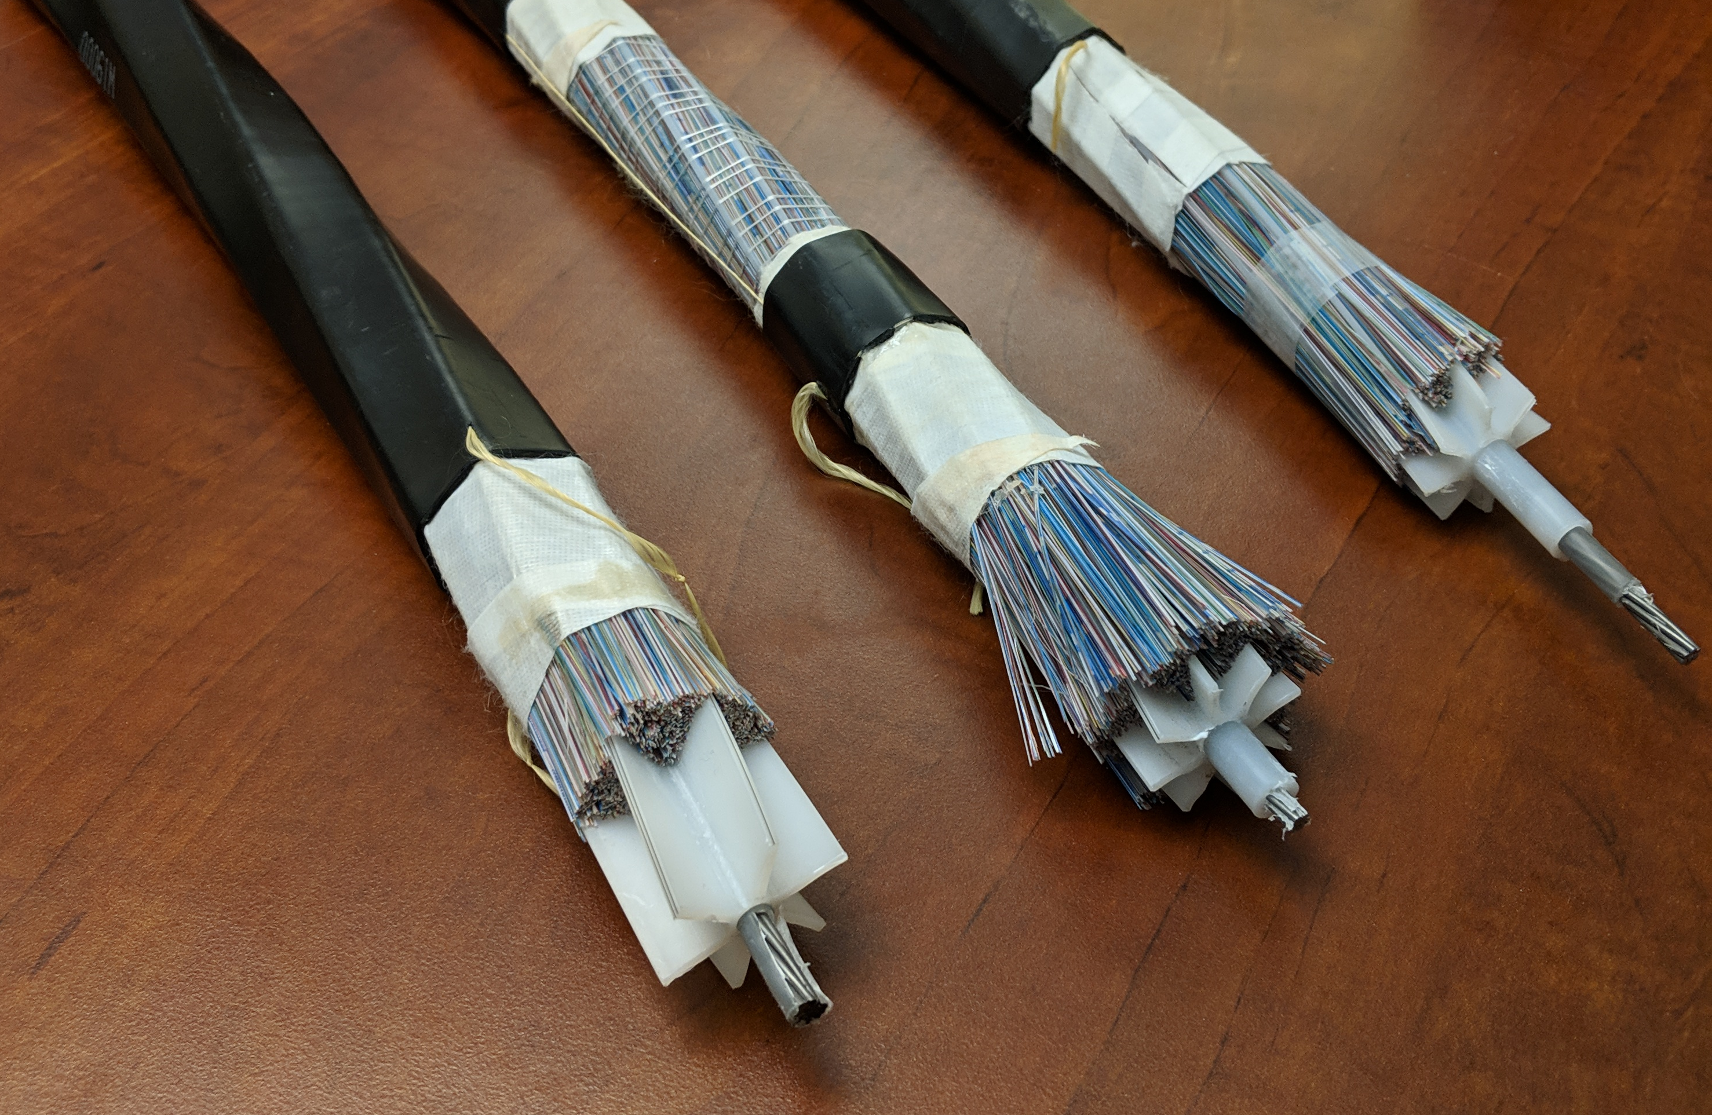
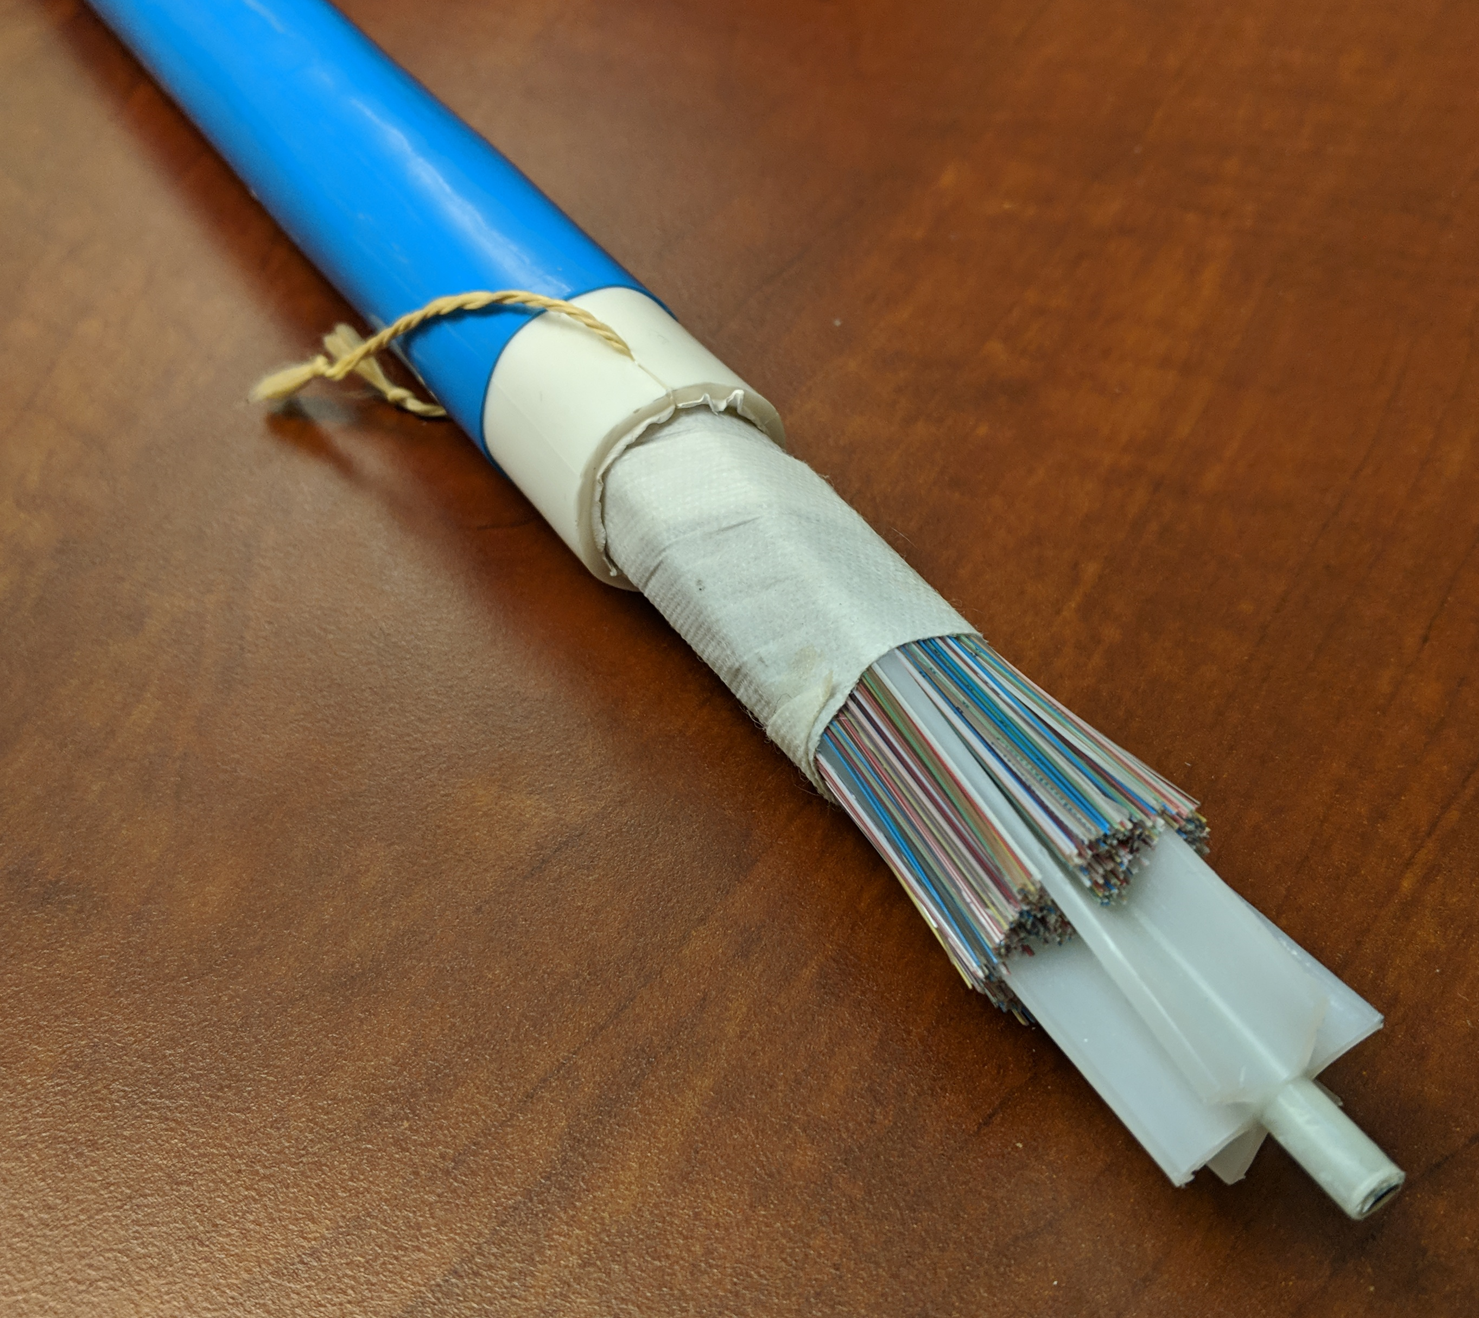
Intra & inter-AZ connectivity
Dark fiber “spans”
Optimized for low-latency & physical diversity
Amazon controlled infrastructure
Geospatial coordinates
Dense wavelength division multiplexing (DWDM)
Notes:
AWS runs its own dark network to connect its availability zones. This privately owned backbone only carries amazon traffic. The cable connects each AZ and also between AZs.
The standard cable contains 3,456 strands around a steel core. The steel core provides strength and also allows for tracing of cable using magnetometers.
The most recent cables double the number of strands to 6,912.
We runn 100G over each strand. To further increase our data capacity, we employ Dense Wave Division Multiplexing.
White light can be separated into different colours. Think of a rainbow. In WDM, light is split into different frequency channels and each channel is independent of the other.
Using this technology we can support up to 160 channels over a single strand. This increases data rate from 100 GbS to 16 TbS
Blue cable is from Australia where it protects from termintes that like eating cables

Slide 22


Availability Zones
Region is comprised of multiple Availability Zones
Isolation from other Availability Zones (power, network, flood plains)
Low latency (<10mS) direct connect between Availability Zones
1AZ can include multiple data centers
Physical Separation < 100km
us-east-1 (N.Virginia)
Region
Availability Zone
Availability Zone
Availability Zone
us-east-1a
us-east-1b
us-east-1c

Slide 23
Availability Zones

Slide 24
2
EC2 Overview

Slide 25


Choices for Compute
Amazon EC2
Amazon ECS, EKS, and Fargate
Container management service for running Docker on a managed cluster of EC2
AWS Lambda
Serverless compute for stateless code execution in response to triggers
Amazon EC2
Virtual server instances in the cloud
Notes:
Compute is at the core of nearly every AWS customers’ infrastructure, whether it be in the form of instances, containers or serverless compute. We are delivering choice in how you consume compute to support existing applications and build new applications in the way that suits your business and applications needs. And within each of these areas, we are rapidly adding completely new capabilities.

Slide 26
Amazon EC2
Linux | Windows
Arm and x86 architectures
General purpose and workload optimized
Bare metal, disk, networking capabilities
Amazon EC2
Packaged | Custom | Community AMIs
Multiple purchase options: On-demand, RI, Spot
Notes:
Instances is the most mature area of our compute platform with deep investment and long running proven experience. It is also where customers have the greatest need for choice to support their current and future applications. For instances, we offer choice across a number of dimensions. You have your choice of operating systems with Linux and Windows as well as choice of architectures with support for X86 and Arm workloads. For those workloads, we have instances which are general purpose as well as optimized for specific needs such compute-optimized for HPC workload or memory-optimized for big data and analytics. Over the last year, we have introduce new capabilities to enhance our instances with bare metal, attached SSD and most recently, enhanced networking. These instances are packaged for you in many ways – you can choose one of our AMIs, you can customize your own images or you can select from additional varieties of AMIs provided by our community. And those instances are available through flexibility in purchase models to meet your business and budget needs.

Slide 27
EC2 Terminology
AZ
Availability Zone
Instance
VPC
VPC
AMI
EBS
EBS
EBS
EBS
EBS
EBS
Virtual Machine Configuration
Running or Stopped VM
Amazon S3
EBS Snapshots
S3 Buckets
Region
Notes:
Walk through the terminology from what an AMI is, launching an instance into a specific network environment, in specific AZ/Region, there are multiple regions, block storage is in an AZ, S3 is regional and holds snapshots.

Slide 28
What’s a virtual CPU? (vCPU)
A vCPU is typically a hyper-threaded physical core*
Divide vCPU count by 2 to get core count
On Linux, “A” threads enumerated before “B” threads
On Windows, threads are interleaved
Cores by Amazon EC2 & RDS DB Instance type: https://aws.amazon.com/ec2/virtualcores/

Slide 29
Memory and Storage
What’s a GiB?
What about storage?
Memory is presented as GibiBytes (GiB) and not Gigabytes (GB)
256 GiB = 275 GB
Storage is independent of compute
You allocate drives known as EBS volumes
Max 16 TiB per volume
Notes:
EBS Volume Limits:
Amazon Linux: 40
Windows: 26
Nitro: 28
I3.metal: 31
U.metal: 13

Slide 30
Instance sizing
≈
≈
≈
c4.8xlarge
2 - c4.4xlarge
4 - c4.2xlarge
8 - c4.xlarge

Slide 31
Resource allocation
All resources assigned to you are dedicated to your instance with no over commitment*
All vCPUs are dedicated to you
Memory allocated is assigned only to your instance
Network resources are partitioned to avoid “noisy neighbors”
Curious about the number of instances per host?
See “Dedicated Hosts Configuration Table” for a guide.
*Again, the “T” family is special

Slide 32
EC2 Naming Explained
Instance generation
c5n.xlarge
Instance
family
Attribute
Instance size

Slide 33
EC2 Operating Systems Supported
Windows 2003R2/2008/2008R2/2012/2012R2/2016
Amazon Linux
Debian
Suse
CentOS
Red Hat Enterprise Linux
Ubuntu
for more OSes see: https://aws.amazon.com/marketplace/b/2649367011

Slide 34

Windows Licenses by Cloud Provider
Others
Azure
Note: Includes Windows instances deployed in the public cloud IaaS market during 2017 Source: IDC estimates, 2018
IDC, Windows Server Operating Environment Market Update, Doc # US44217118, Aug 2018
https://d1.awsstatic.com/analyst-reports/IDC_Slide_WindowsonAWS_JM181015.pdf
Notes:
And the data shows customers are choosing AWS as the platform for Windows. Based on data from IDC, we know that 2x of the market segment share of Windows Workloads are on AWS. In fact, 57.7% of market segment share is done on AWS of all Windows in the Cloud!
ReInvent 2018
© 2018, Amazon Web Services, Inc. or its Affiliates. All rights reserved.
5/8/19 12:11 AM

Slide 35




Choose your processor and architecture
2
NEW!
NEW!
Intel® Xeon® Scalable (Skylake) processor
NVIDIA V100 Tensor Core GPUs
AMD EPYC processor
Amazon ARM based Cloud Processor
Right compute for the right application and workload
Notes:
Beyond the operating system, we are providing you the choice of processor and architecture to build the applications you need with the flexibility in choice that you want. We believe that by providing greater choice, customers can choose the right compute to power their application and workload.
We have had a rich and long-term partnership with Intel and the Skylake processor is key to powering our most powerful instances. NVDIA helps to power your machine learning and graphics workloads. In early November, we announced our support for AMD and the AMD EPYC processor and we are the only cloud with AMD available today. Lastly we announced that AWS has released a new processor, the Graviton processor, based on Arm-architectures. Now we are the only major cloud provider to support Arm workloads. Customers have told us processor choice matters to them and we are already seeing customer testing their apps with these new instances and processors.

Slide 36

What is an Amazon Machine Image (AMI)?
AMI
Provides the information required to launch an instance
Launch multiple instances from a single AMI
An AMI includes the following
A template for the root volume (for example, operating system, applications)
Launch permissions that control which AWS accounts can use the AMI
Block device mapping that specifies volumes to attach to the instance

Slide 37
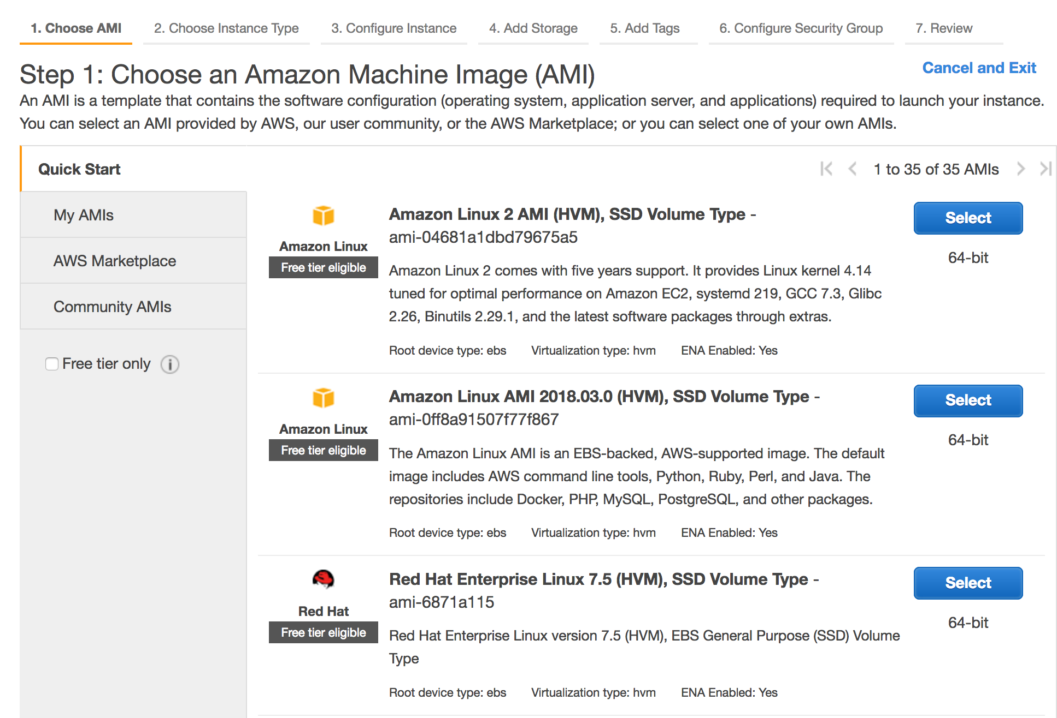
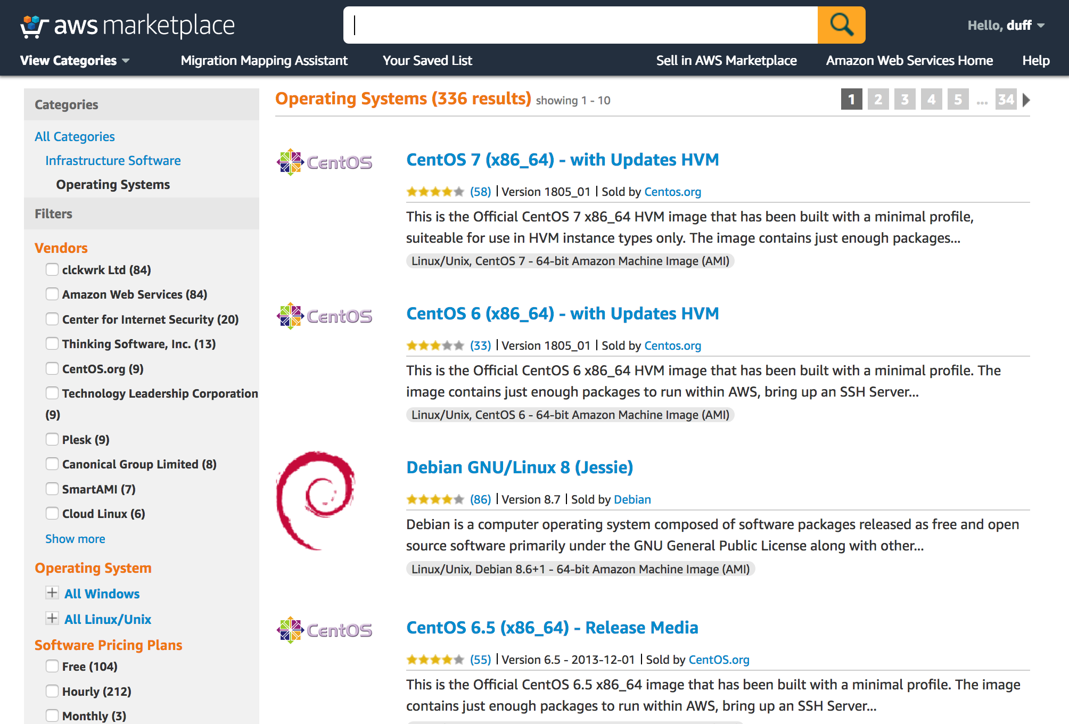
Choosing an AMI
AWS Console
AWS Marketplace
Use the AMI ID to launch through the API or AWS Command Line Interface (AWS CLI)
aws ec2 run-instances --image-id ami-04681a1dbd79675a5 --instance-type c4.8xlarge --count 10 --key-name MyKey

Slide 38
Instance Types
NEW
Amazon Lightsail
T3
M5
D2
H1
R5
R5m
X1
X1e
I3
I3m
C5
G3
P3
F1
Z1d
Z1 dm
Virtual Private Servers
Burstable
General Purpose
Dense Storage
Big Data Optimized
Memory Optimized
In-memory
Memory Intensive
High I/O
Bare Metal High I/O
Compute Intensive
Graphics Intensive
General Purpose GPU
FPGA
Compute and Memory Intensive
EC2 Elastic GPUs
Graphics acceleration for EC2 instances
EC2 Fleet
Simplified provisioning
Massive scale
Flexible capacity allocation
Notes:
One of the very clear ways that this manifests itself is in our instance delivery, where every year we ensure that you all have the absolute latest and greatest platforms on which to build your applications. I won’t go through each and every new instance that we launched this past year, but I will point out a couple of the highlights.

Slide 39

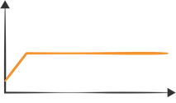
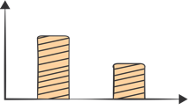
Purchasing options at a glance
On-Demand
Instances
Reserved Instances
Spot Instances
Pay for compute capacity by the hour with no long-term commitments
Make a low, one-time payment and receive a significant discount on the hourly charge
Bid for unused capacity, charged at a spot price which fluctuates based on supply and demand
For Spiky workloads or to define needs
For committed utilization
For time-insensitive or transient workloads
Notes:
Explain how pricing works, integrate our new SPOT model with 1-6 hours. Great slide to just talk and whiteboard out how our offerings could be bought in a hybrid model. Some Spot, some Demand, and some RI.

Slide 40
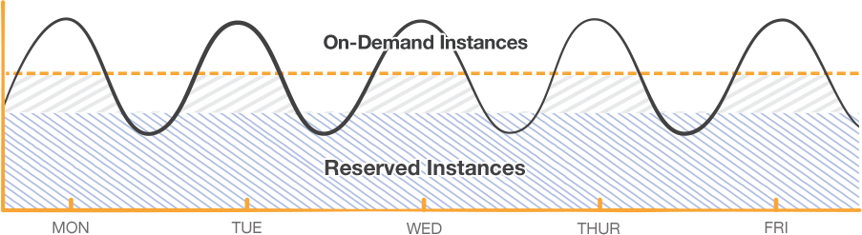
Layer your options
Notes:
Traditional Data Center use and how the old model of purchasing more than needed can still translate in to the Cloud. Buy what you know is your baseline and utilized On-Demand or Spot for Excess.

Slide 41
EC2 Options
Categories
Capabilities
Options
General purpose
Choice of processor
(AWS, Intel, AMD)
.metal
NEW!
175
.metal
Burstable
Fast processors
(up to 4.0 GHz)
.metal
.metal
Compute intensive
Elastic Block Store
.metal
.metal
High memory footprint
(up to 12 TiB)
instance types
Memory intensive
Elastic Graphics
.metal
.metal
for virtually every workload and business need
Storage (High I/O)
Instance storage
(HDD and NVMe)
Elastic Inference
.metal
+
+
NEW!
.metal
=
.metal
Dense storage
.metal
Accelerated computing
(GPUs and FPGA)
.metal
GPU compute
Graphics intensive
Networking
(up to 100 Gbps)
NEW!
Bare Metal
Size
(Nano to 32xlarge)
Notes:
As we take a step back, let’s bring this all together as the choice we offer with our instances. Part of customer choice is delivering on your specific workloads needs. We have done that with innovating on our general purpose and burstable workloads as well as bring specialized instances to market like z1d for design automation. We have invested in new capabilities over the last year such as faster processors working with Intel, introducing new instances for accelerate computing and now enhanced networking to remove network bottlenecks for high performance workloads. As we just discussed, you can also add options such as Elastic Graphics or Elastic Inference and of course Elastic Block Store to provide greater performance and storage flexibility with instance storage.
As all this comes together, we have 175 instances types today, more than the next major cloud provider and nearly triple the number of instances launched this year relative to last year. We plan to continue to bring new instances to market such as more bare metal instance and will have instances to support virtually every workload and business need.

Slide 42
3
EC2 Design

Slide 43
EC2 Host Virtualization
Small
Large
…
Small
Customer
Instances
Hypervisor
…
Virtual Interfaces
Physical Host
Security Groups
Security Groups
Security Groups
Firewall
Physical Interfaces
Notes:
High-level description of what happens when an instance is launched from a hypervisor slot perspective. For example:
We use a highly modified version of the Xen hypervisor.
When and instance is launched, we look across our fleet for an available slot to run their instance.
When an instance is launched, we hard partition both the memory and CPU allocation so we are not ballooning memory or oversubscribing memory or CPU – with the exception of the micro instance.
Every instance must be launched with at least one security group, which controls all network access in and out of the instance. Security groups control access regardless of whether the instance is talking to another instance attached to the same hypervisor, is within the same AZ, another AZ, or across the world.

Slide 44
Which hypervisor do we use?
Original: Xen
Original hypervisor
Consumed excessive resources
Limited optimization
New (Nov/2017): Custom KVM based hypervisor
Nitro instances
Less server resources used, more resources for the customer
AWS optimized
Bare metal: No AWS provided hypervisor

Slide 45
AWS Nitro System
Nitro Hypervisor
Nitro Card
Nitro Security Chip
Lightweight hypervisor
Memory and CPU allocation
Bare Metal-like performance
VPC Networking
Amazon EBS
Local Instance
System Controller
Integrated into motherboard
Protects hardware resources
Hardware Root of Trust
Modular Building Blocks for rapid design and delivery of EC2 instances
Notes:
For starters, several years ago we started an on effort to completely re-imagine our virtualization infrastructure with what we call the Nitro system. The idea was that traditionally a hypervisor had to do a ton of things – it had to protect the physical hardware and bios, it had to virtualize the CPU, virtualize the storage, virtualize the networking, and provide a rich set of management capabilities.
With Nitro, our idea was that we could break apart all of those functions into separate components, provide better performance for customers, better security, and would be able to reduce our costs by delivering all of the resources of a server to customers vs having to hold some back for the management software. So that is what we did.
The Nitro system is a rich collection of building blocks that can be assembled in many different ways, giving us the flexibility to design and rapidly deliver EC2 instance types with an ever-broadening selection of compute, storage, memory, and networking options. We will deliver new instance types more quickly than ever in the months to come, with the goal of helping you to build, migrate, and run even more types of workloads.
Local NVMe Storage – The new C5d, M5d, and bare metal EC2 instances feature our Nitro local NVMe storage building block, which is also used in the Xen-virtualized I3 and F1 instances. This building block provides direct access to high-speed local storage over a PCI interface and transparently encrypts all data using dedicated hardware. It also provides hardware-level isolation between storage devices and EC2 instances so that bare metal instances can benefit from local NVMe storage.
Nitro Security Chip – A component that is part of our AWS server designs that continuously monitors and protects hardware resources and independently verifies firmware each time a system boots.
Nitro Hypervisor – A thin, quiescent hypervisor that manages memory and CPU allocation, and delivers performance that is indistinguishable from bare metal for most workloads
Networking – Hardware support for the software defined network inside of each Virtual Private Cloud (VPC), Enhanced Networking, and Elastic Network Adapter.
Elastic Block Storage – Hardware EBS processing including CPU-intensive cryptographic operations.
Moving storage, networking, and security functions to hardware has important consequences for both bare metal and virtualized instance types:
Virtualized instances can make just about all of the host’s CPU power and memory available to the guest operating systems since the hypervisor plays a greatly diminished role.
Bare metal instances have full access to the hardware, but also have the same the flexibility and feature set as virtualized EC2 instances including CloudWatch metrics, EBS, and VPC.

Slide 46
AWS Nitro System
1.3X
1.2X
1.5X
without Nitro
Nitro instances provide bandwidth, performance, and price improvements over previous instance generations
Notes:
C5 and M5 are our first Nitro-based instances with many more to come. They feature the latest Intel Skylake processors, and provide a 25-50% price performance improvement over previous C/M generations depending on your specific workload. They also provide a 50-80% improvement in bandwidth and 20-30% improvement in IOPS over previous C/M generations.

Slide 47
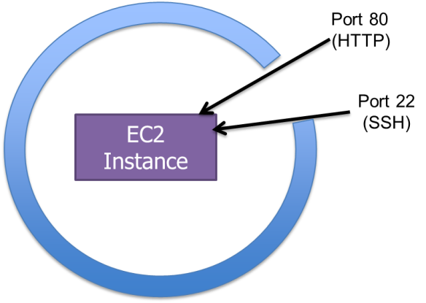
EC2 Security Groups
Security Group Rules
Name
Description
Protocol
Port range
IP address, IP range, Security Group name
Notes:
High-level description of Security Groups. Focus on how they control network traffic and the differences between EC2 Classic and VPC security groups.

Slide 48
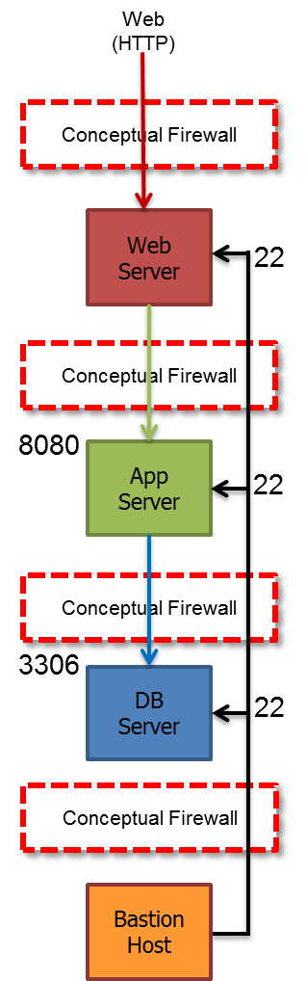
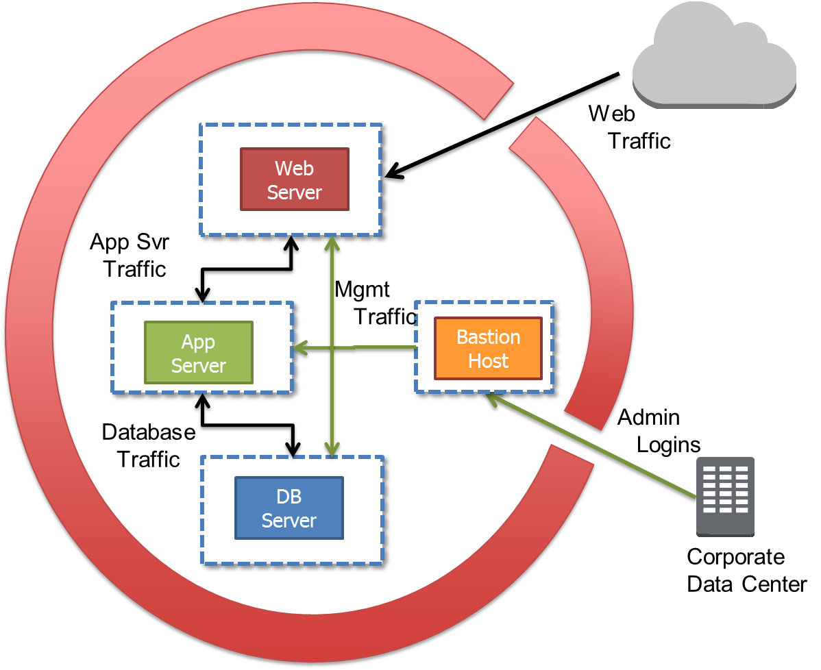
Tiered EC2 Security Groups
Hierarchical Security Group Rules
Dynamically created rules
Based on Security Group membership
Create tiered network architectures
“Web” Security Group:
TCP 80 0.0.0.0/0
TCP 22 “Mgmt”
“App” Security Group:
TCP 8080 “Web”
TCP 22 “Mgmt”
“DB” Security Group:
TCP 3306 “App”
TCP 22 “Mgmt”
“Mgmt” Security Group:
TCP 22 163.128.25.32/32
Notes:
Go into more detail about how Security Groups are the customer’s way to control traffic flow and create tiered network architectures in their environment. The diagrams on the left and right are representing the same thing – they are just different ways of visualizing the rules in the middle. We find each representation resonates differently with different customers. Explain how these rules control the flow of traffic from the web through the DB layer by having security groups reference other security groups.
Stress that none of the server groups (e.g. Web, App, DB) can talk with each other just because they are in the same Security Group. That a specific, self-referencing rule would need to be created to allow this traffic. Also stress how these rules will be dynamically updated as instances are added or removed from each server farm.

Slide 49
EC2 IP Addressing
Default VPC | Virtual Private Cloud
Dynamic Private IP | Dynamic or Static Private IP Address
Dynamic Public IP | None by default (can be created with publicIP=true)
Optional Static Public IP (EIP) | Optional Static Public IP (EIP)
AWS-provided DNS names Private DNS name Public DNS name | AWS-provided public DNS lookup AWS-provided private DNS names Customer-controlled DNS options
Notes:
Overview of IP addressing in EC2.

Slide 50

EC2-Specific Credentials
EC2 key pairs
Linux – SSH key pair for first-time host login
Windows – Retrieve Administrator password
Standard SSH RSA key pair
Public/Private Keys
Private keys are not stored by AWS
AWS approach for providing initial access to a generic OS
Secure
Personalized
Non-generic (NIST, PCI DSS)
“Public Half” inserted by Amazon into each EC2 instance that you launch
“Private Half” downloaded to your desktop
Notes:
Discuss how AWS leverages standard SSH key pairs to provide initial access to the OS for our customers. Highlight how we can create the key pair and give them one chance to download the private key, or they can create the keys themselves and just upload the public key. Keypairs are used to provide initial SSH access to Linux hosts and to retrieve the Administrator password on Windows hosts.
Stress that this is intended to be used for initial access in a secure, personalized, non-vendor supplied default password manner. Our expectation is that the customer will use this access to join the computer to a domain or other centralized OS access management solution (e.g. LDAP, AD)

Slide 51
EC2 Instance access and Key Pairs
Instance metadata
Linux launch (first boot)
Public key made available through metadata
Public key inserted into ~/.ssh/authorized_keys
User connects with SSH using their private key
RSA public key
Instance
Notes:
Describe how Linux instruments the key pair by obtaining the public key from instance metadata and inserting the public key into the SSH authorized_keys file on first boot. Then the user connects via SSH just like any other SSH session.

Slide 52
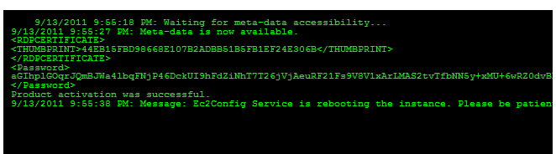
EC2 Instance access and Key Pairs
Instance metadata
RSA public key
Linux launch (first boot)
Public key made available through metadata
Public key inserted into ~/.ssh/authorized_keys
User connects with SSH using their private key
Windows launch (first boot sequence)
Public key made available through metadata
Sysprep
Random Administrator password
Password encrypted with public key
User decrypts password with their private key
Instance
System log
<Password> aGIhplGOqrJQmBJW
…
K9gTD31Q== </Password>
Notes:
Describe how Windows has a boot sequence that is required by SysPrep. The boot sequence includes start-up scripts that create a random Administrator password, obtains the public key from instance metadata, encrypts the Admin password with the public key, and makes the encrypted password available via the system log. The user can use the AWS management console or the EC2 API to retrieve the encrypted password from the system log and decrypt it with their private key. Then they use RDP to connect to the Windows instance as Administrator with their decrypted password.

Slide 53
Instance Metadata
http://169.254.169.254/latest/meta-data/ contains a wealth of info
ami-id
ami-launch-index
ami-manifest-path
block-device-mapping/
hostname
instance-action
instance-id
instance-type
kernel-id
local-hostname
local-ipv4
mac
network/
placement/availability-zone
profile
public-hostname
public-ipv4
public-keys/
Notes:
Mention that AWS provides a rich set of metadata that is available to an instance by querying the special URL. This is only available from within the OS of the instance itself and can help with infrastructure automation. For example, the instance may need to know its instance ID, and can query the instance metadata service. Another example may be that the instance needs to know which AZ it is in to apply AZ-specific configuration details.

Slide 54

Any Questions?

Slide 55
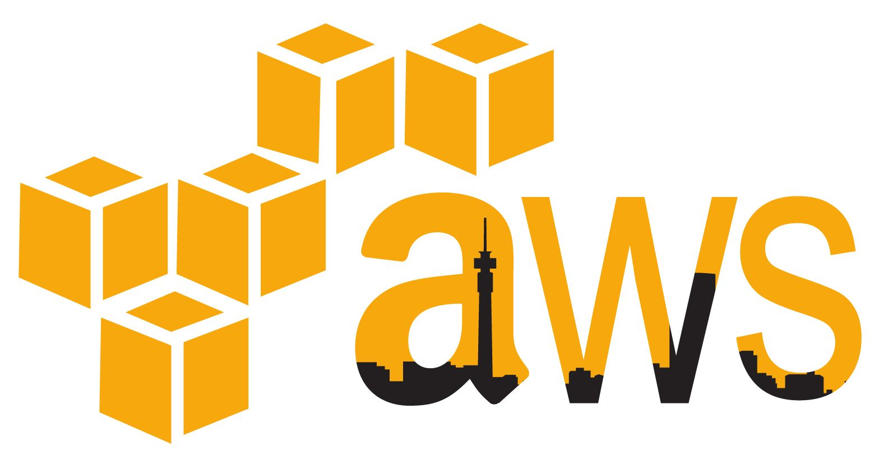
Hands-on Labs
Bootcamp AWS Account:
URL: https://coveobootcamp.signin.aws.amazon.com/console
User: coveo{1..50}
Password:
Region: N. Virginia
Labs are here: https://github.com/ricardoadrianpeters/coveo

